Slide 1

SOUTHEAST UNIVERSITY
Course Title: Numerical Methods
Course Code: SEU527
Instructor: Lubna Yasmin Pinky
PRESENTED BY
Name: Motiur Rahman
ID: 2022100010048
Batch: 14

Slide 2
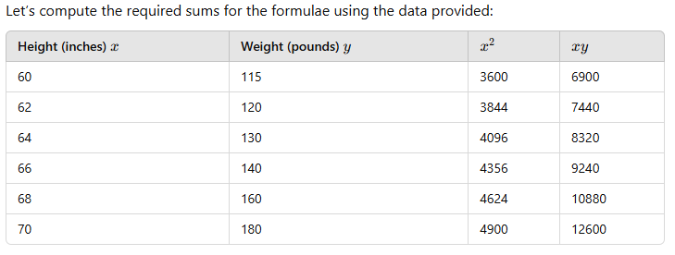
SUMMING THE DATA

Slide 3
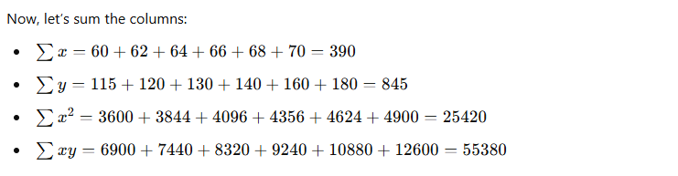
SUM THE COLUMNS

Slide 4
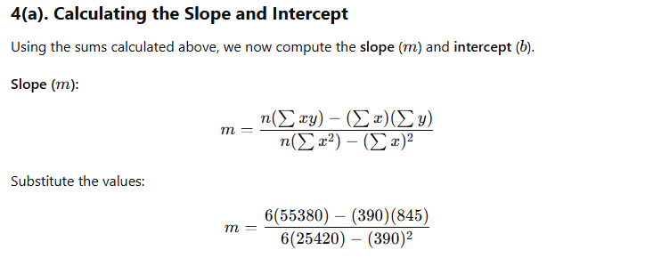
SLOPE AND INTERCEPT

Slide 5
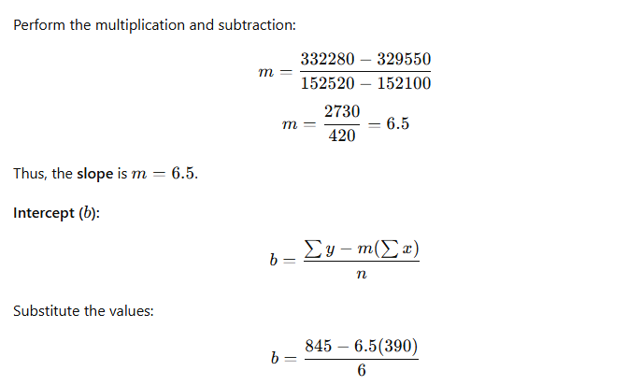
SLOPE AND INTERCEPT

Slide 6
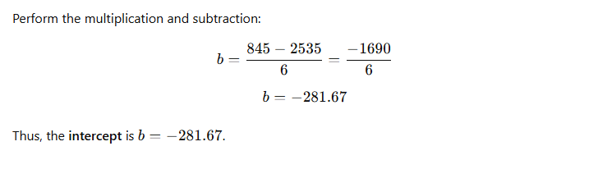
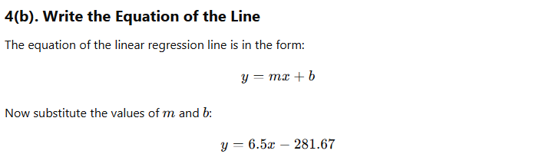
SLOPE AND INTERCEPT

Slide 7
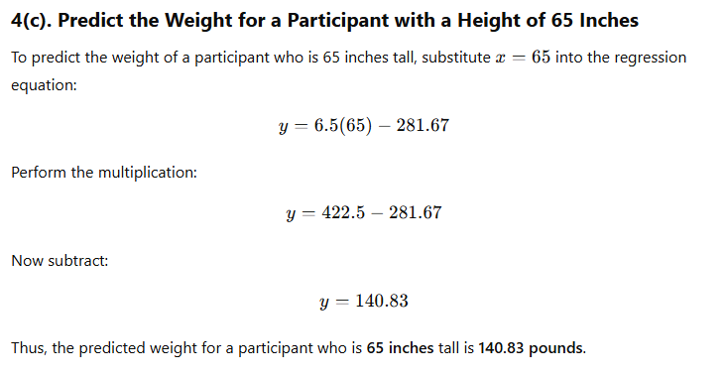
WEIGHT FOR A PARTICIPANT

